Slide 1
DS Capstone Project Report
Introduction
In this project, the focus is on NYC data. First, we will find the most visited commercial shop according to the number of check-ins, then we will try to find the neighborhoods that are lacking the selected type of shop which could be potential business opportunity.
Target User
The target audience of this report is any one that is interested in opening a shop but have no idea what kind of and in which neighborhood.
Data Section
https://sites.google.com/site/yangdingqi/home/foursquare-dataset. It contains 227,428 check-ins in NYC. The data contains two files in CSV format. Each file contains 8 columns, which are:
User ID
Venue ID (Foursquare)
Venue category ID (Foursquare)
Venue category name (Foursquare)
Latitude

Slide 2
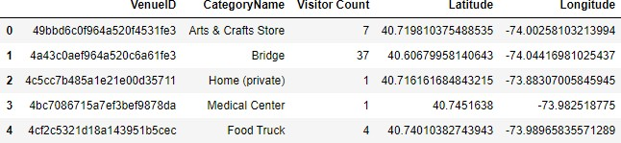
Longitude
Time zone offset in minutes (The offset in minutes between when this check-in occurred and the same time in UTC)
UTC time
After extracting and reading the data, we will translate the above data into a Pandas
data frame for processing which would look like this. These are the data elements that are needed when we call Foursquare web service call in order to get the venues available in that neighborhood (Neighborhoods are not included here)
Then we will create a dictionary in order to decide which category is the
most popular (commercial type)

Slide 3
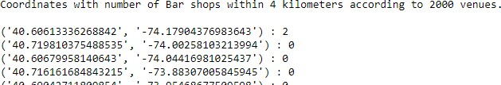
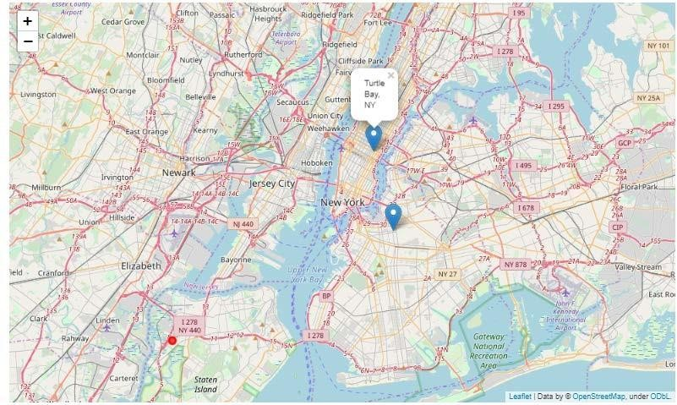
After all this, we will check the coordinates within given n number of kilometers and
count how many ‘Bar’ are there (venues selected as 2000 as a trial)
Find the two neighborhoods that are closest to the coordinate which has the most
number of the specific shop type but lacking that within 4 kilometers
Red dot is the center

Slide 4
Results & Conclusion
In our sample of 2000 venues, we did find more than 10 coordinates that has no bar (the most visited shop type according to sample) within four-kilometer sphere. And we did manage to get the neighborhoods’ names from foursquare database and pin down the two closest neighborhoods, ‘Bedford-Stuyvesant’, and ‘Turtle Bay’, into the map. Of course, it should not be forgotten that the data used above is almost 6-year old so further research might be needed.
Anyways, the results according to the data in hand can be checked from the map and analysis above can be of use for future entrepreneurs.

